Slide 1
CUSTOMER ANALYTICS | STRATEGIC INSIGHTS ENGAGEMENT
Customer Segmentation &
Retail Growth Strategy
An Executive Consulting Presentation on Data-Driven Customer Intelligence, K-Means Segmentation, and Targeted Marketing Strategy
PREPARED FOR
Executive Leadership & Marketing Strategy Committee
PREPARED BY
Sanchit Sunil Koli
Data Analytics Intern | Business Intelligence & Customer Analytics
July 2026

Slide 2
AGENDA
What We'll Cover
01
Engagement Overview & Objectives
05
Customer Behavior Drivers
02
Data Quality & Methodology
06
K-Means Customer Segmentation
03
Business Performance Snapshot
07
Business Intelligence Dashboards
04
Category & Discount Strategy
08
Strategic Recommendations & Roadmap
CUSTOMER SEGMENTATION & RETAIL GROWTH STRATEGY
Prepared by Sanchit Sunil Koli | 2

Slide 3
EXECUTIVE SUMMARY
Precision Targeting, Not Broader Discounting, Is the Growth Lever
A structured analysis of 3,900 customer transactions reveals a customer base with five distinct behavioral segments — and shows that revenue is driven primarily by customer volume, not by individual spend.
3,900
$233,081
$59.76
5
CUSTOMER RECORDS
TOTAL REVENUE
AVG. PURCHASE VALUE
CUSTOMER SEGMENTS
Clothing and Accessories together generate 76.6% of total revenue; Outerwear trails at just 7.95% — a targeting gap, not a pricing problem.
Average purchase value is nearly flat across age groups and seasons ($59–$61) — revenue differences trace back to customer count, not spend per customer.
Discounted vs. non-discounted transactions differ by less than $1 on average — blanket discounting is not supported by the data.
K-Means clustering (k=5) identifies five behaviorally distinct segments, from High-Value Loyal Customers to Occasional Senior Customers.
STRATEGIC VERDICT
The business does not have a demand problem — it has a targeting problem. The highest-value opportunity is precision segmentation: retain high-value clusters, re-engage price-sensitive and occasional segments, and redirect promotional spend toward underserved categories and age groups.
CUSTOMER SEGMENTATION & RETAIL GROWTH STRATEGY
Prepared by Sanchit Sunil Koli | 3

Slide 4
01
BUSINESS CONTEXT
Engagement Objectives
Undifferentiated marketing erodes margin without reliably driving demand. This engagement builds an evidence-based view of who customers are, what drives their spending, and how investment should be allocated.
1
2
3
4
5
Validate the Data
Quantify Category Performance
Segment the Customer Base
Prioritize Actions
Productize the Insight
Establish a clean, analysis-ready view of customer behavior across category, age, season, and geography.
Identify which product categories warrant promotional investment vs. which already perform at capacity.
Apply K-Means clustering to reveal behaviorally distinct, actionable customer groups.
Translate findings into prioritized recommendations with quantified expected impact.
Deliver Power BI dashboards so findings remain live and decision-ready beyond this report.
CUSTOMER SEGMENTATION & RETAIL GROWTH STRATEGY
Prepared by Sanchit Sunil Koli | 4

Slide 5
02
METHODOLOGY
A Validated Pipeline, Start to Finish
Data Validation
Business-Question Analysis
Customer Segmentation
Dashboard Productization
→
→
→
Excel — filters, IQR box plots
SQL, Excel
Python — K-Means (scikit-learn)
Power BI
A Six-Point Data Quality Validation
✓
Missing Values
✓
Duplicate Records
✓
Data Types
None found
None found
All valid
✓
Text Standardization
✓
Outlier Detection (IQR)
✓
Final Validation
Fully consistent
None detected
Fully passed
KEY INSIGHT
No missing values, duplicates, type errors, or outliers were identified — the dataset required no remediation and supports every finding in this presentation with a high degree of confidence.
CUSTOMER SEGMENTATION & RETAIL GROWTH STRATEGY
Prepared by Sanchit Sunil Koli | 5

Slide 6
03
PERFORMANCE SNAPSHOT
Business Performance Overview
These figures represent the full 3,900-record transaction base and form the baseline for every category, demographic, and segment comparison in this presentation.
3,900
$233,081
$59.76
44.07 yrs
3.75 / 5
TOTAL CUSTOMER RECORDS
TOTAL REVENUE
AVG. PURCHASE AMOUNT
AVERAGE CUSTOMER AGE
AVERAGE REVIEW RATING
A sample of 3,900 transactions provides a statistically reliable base for segment- and category-level decision-making.
An average review rating of 3.75/5 indicates a generally satisfied customer base — with clear room to improve within specific segments identified later in this deck.
A balanced average customer age of 44.07 years signals a mature, adult-dominated customer base rather than a youth-skewed one, with direct implications for channel and messaging strategy.
CUSTOMER SEGMENTATION & RETAIL GROWTH STRATEGY
Prepared by Sanchit Sunil Koli | 6

Slide 7
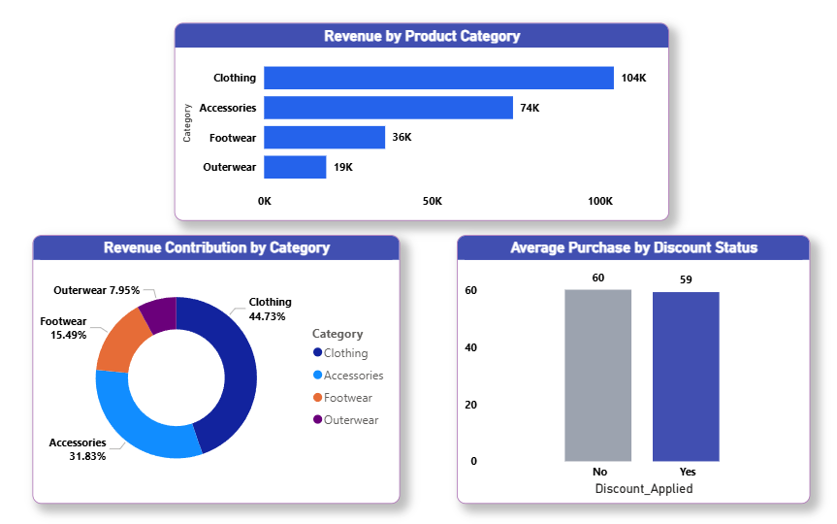
04
CATEGORY STRATEGY
Discount Broadly? The Data Says No.
Clothing generates $104,264 (44.73%) of revenue — the strongest category by far.
Clothing + Accessories together account for over 76% of total revenue.
Outerwear contributes just 7.95% of revenue with the fewest orders.
Discounted ($59.28) vs. non-discounted ($60.13) transactions differ by under $1 — discounting isn't moving spend.
RECOMMENDATION
Do not extend discounts to already-strong categories. Launch time-bound, seasonally-timed Outerwear campaigns paired with merchandising visibility — the constraint is demand awareness, not price.
Revenue Contribution, Order Volume & Discount Impact by Category
CUSTOMER SEGMENTATION & RETAIL GROWTH STRATEGY
Prepared by Sanchit Sunil Koli | 7

Slide 8
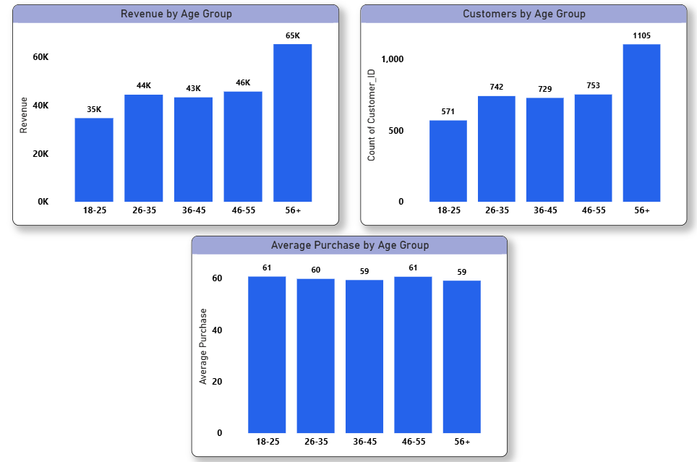
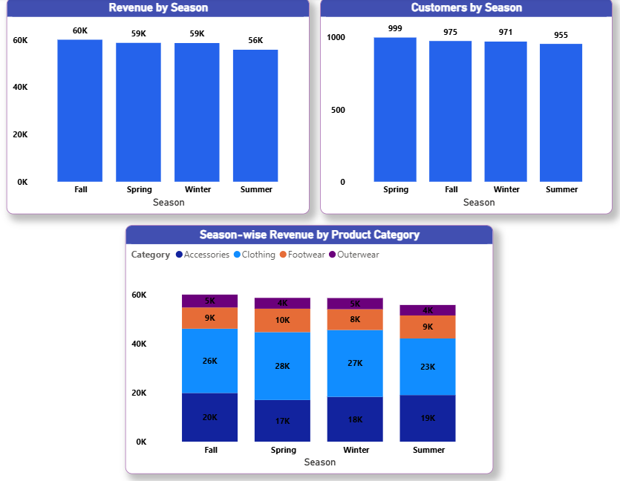
05
CUSTOMER BEHAVIOR DRIVERS
Volume Drives Revenue — Not Individual Spend
Revenue, Customers & Avg. Purchase by Age Group
Revenue & Customer Volume by Season
56+ customers generate the highest revenue ($65K) from the largest base (1,105 customers).
18–25 generates the least ($35K, 571 customers) — an engagement gap, not a spending gap.
Avg. purchase stays flat ($59–$61) across all age groups.
Revenue is stable across seasons ($56K–$60K) — no meaningful seasonality.
Clothing leads and Outerwear trails in every season alike.
Large seasonal discount campaigns are not supported by the data.
CUSTOMER SEGMENTATION & RETAIL GROWTH STRATEGY
Prepared by Sanchit Sunil Koli | 8

Slide 9
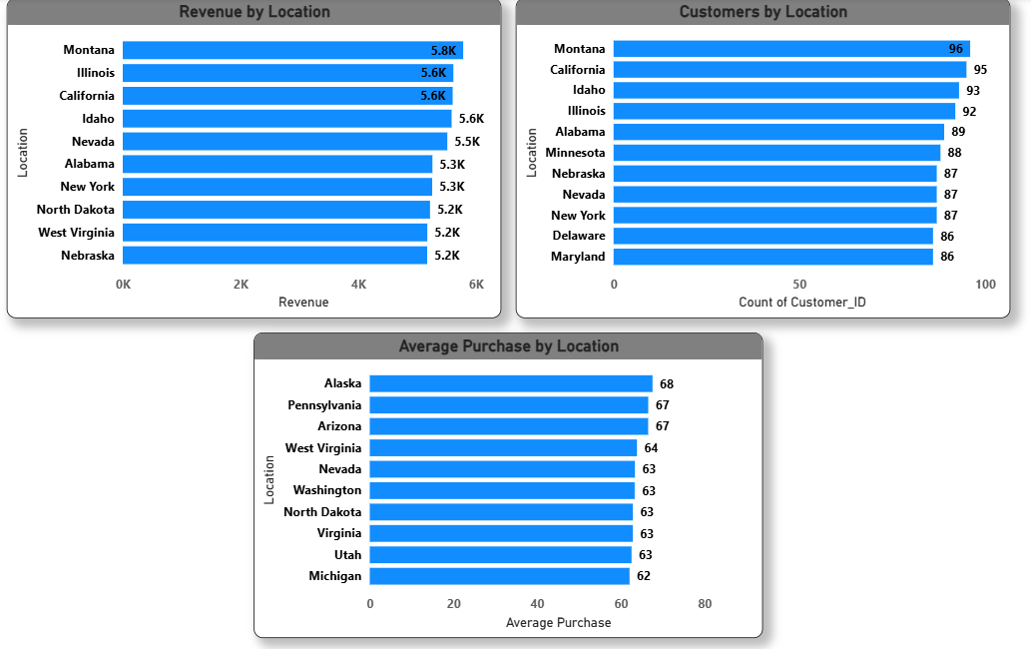
05
CUSTOMER BEHAVIOR DRIVERS
Volume Markets vs. Value Markets
Montana: highest revenue ($5.8K) and highest customer count (96) — a volume-driven market.
Alaska: highest average purchase ($68) despite smaller volume — a value-driven market.
High revenue doesn't always mean high per-customer spend; strategy must fit the market type.
RECOMMENDATION
Apply a two-track regional strategy: acquisition investment in high-volume markets like Montana, and premium/personalized offers in high-value markets like Alaska.
Revenue, Customer Count & Avg. Purchase by Location
CUSTOMER SEGMENTATION & RETAIL GROWTH STRATEGY
Prepared by Sanchit Sunil Koli | 9

Slide 10
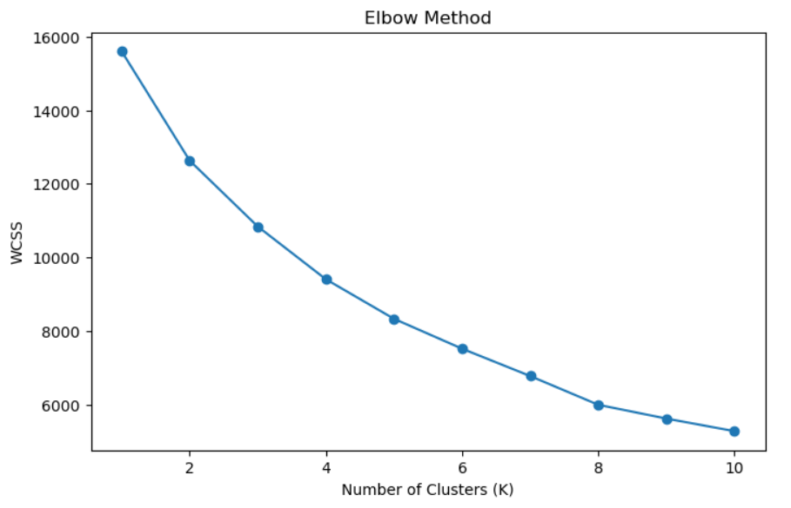
06
CUSTOMER SEGMENTATION
K-Means Clustering: Five Optimal Segments
Age, Purchase Amount, Review Rating, and Previous Purchases were standardized and clustered using K-Means. The Elbow Method identifies K = 5 as the statistically optimal number of segments.
Numerical features were standardized (StandardScaler) so no single variable dominated the distance calculation.
The WCSS curve bends clearly at K = 5 — additional clusters yield only marginal improvement.
The Elbow Method suggested K = 5 as the optimal number of clusters for this dataset.
Elbow Method for Optimal Number of Clusters (K = 5)
CUSTOMER SEGMENTATION & RETAIL GROWTH STRATEGY
Prepared by Sanchit Sunil Koli | 10

Slide 11
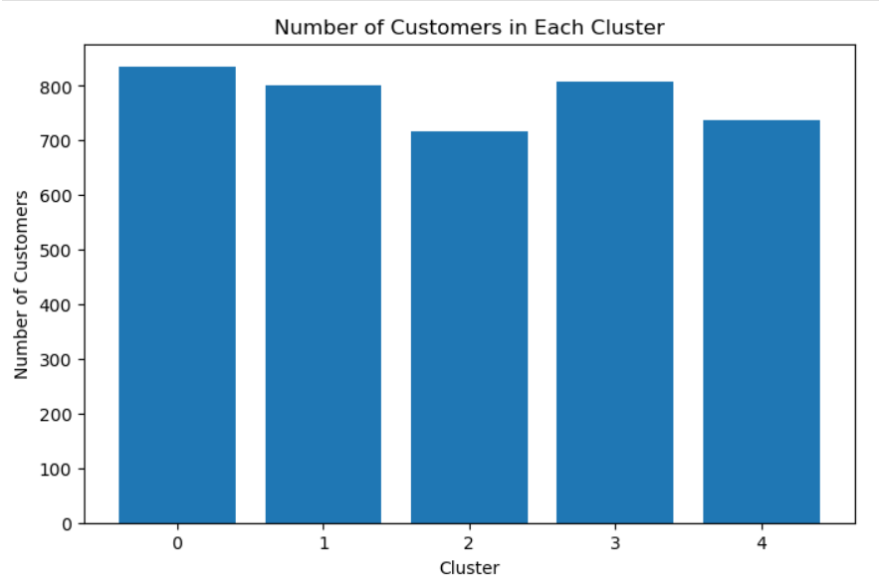
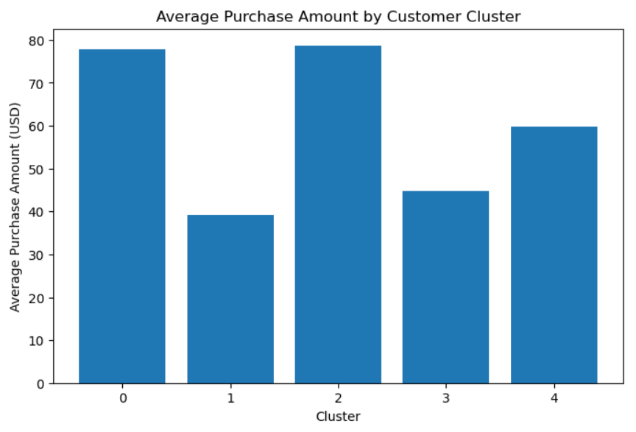
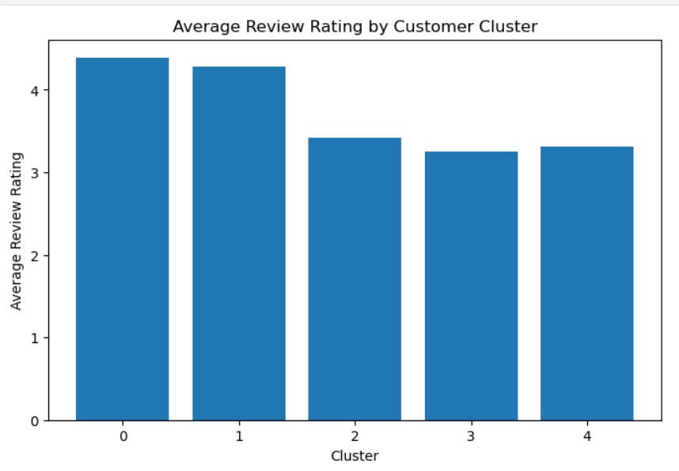
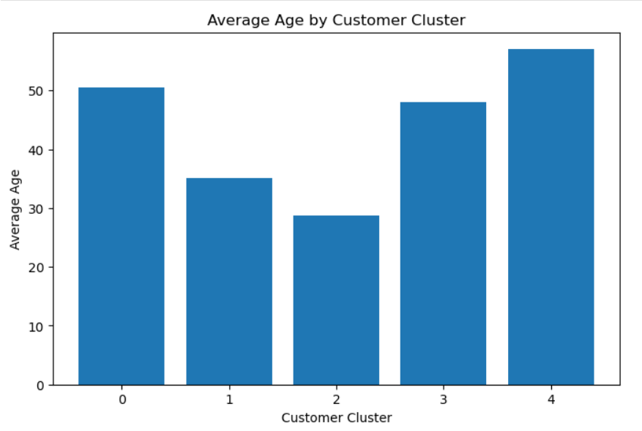
06
CUSTOMER SEGMENTATION
Segment Distribution, Value & Satisfaction
Customer Distribution by Cluster
Avg. Purchase Amount by Cluster
Avg. Review Rating by Cluster
Avg. Age by Cluster
CUSTOMER SEGMENTATION & RETAIL GROWTH STRATEGY
Prepared by Sanchit Sunil Koli | 11

Slide 12
06
CUSTOMER SEGMENTATION
Segment Profiles: I
Cluster 0 — High-Value Loyal
Cluster 1 — Value-Conscious
Cluster 2 — Young High-Spenders
Strong spend, highest satisfaction, largest group
Price-sensitive, lower average spend
Highest spend, youngest segment, lower satisfaction
PROFILE
PROFILE
PROFILE
Largest cluster by customer count, with high average purchase amount and the highest review rating of any segment.
Lowest average purchase amount among all segments, indicating heightened price sensitivity.
Youngest segment with the highest average purchase amount, but satisfaction trails Cluster 0.
STRATEGY
STRATEGY
STRATEGY
Retain via VIP membership tiers, exclusive rewards, personalized recommendations, and early access to launches.
Engage with cashback offers, seasonal discounts, and bundle deals to grow basket size.
Prioritize faster service, personalization, and loyalty benefits to close the satisfaction gap.
Priority: Highest
Priority: Medium
Priority: High
CUSTOMER SEGMENTATION & RETAIL GROWTH STRATEGY
Prepared by Sanchit Sunil Koli | 12

Slide 13
06
CUSTOMER SEGMENTATION
Segment Profiles: II
Cluster 3 — Frequent Budget Shoppers
Cluster 4 — Occasional Senior Customers
Highest repeat frequency, lowest satisfaction
Older demographic, lower purchase frequency
PROFILE
PROFILE
Strongest repeat-purchase behavior of any segment, but the lowest review rating and low spend per transaction.
Oldest customer segment, purchasing less frequently than other clusters — an engagement challenge.
STRATEGY
STRATEGY
Deploy cross-selling, upselling, and reward-based loyalty programs; address the service-quality gap.
Re-engage with personalized communication, seasonal offers, and premium customer support.
Priority: Medium-High
Priority: Medium
CUSTOMER SEGMENTATION & RETAIL GROWTH STRATEGY
Prepared by Sanchit Sunil Koli | 13

Slide 14
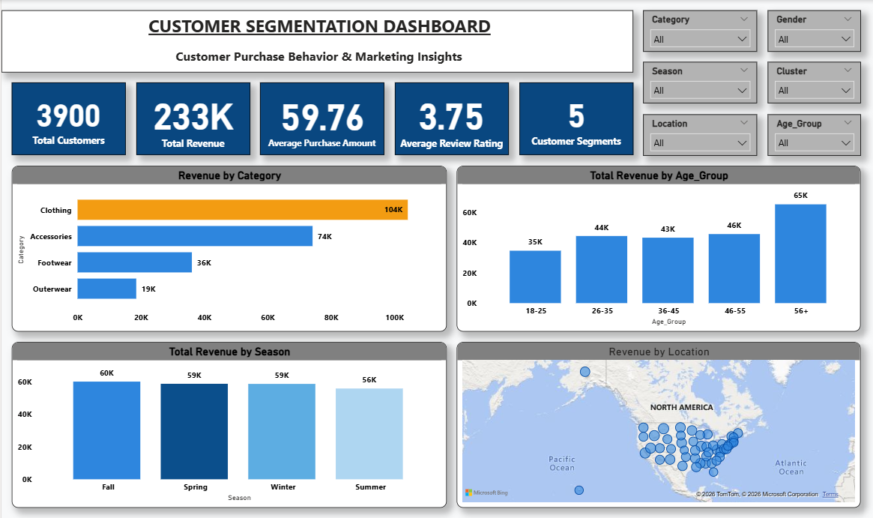
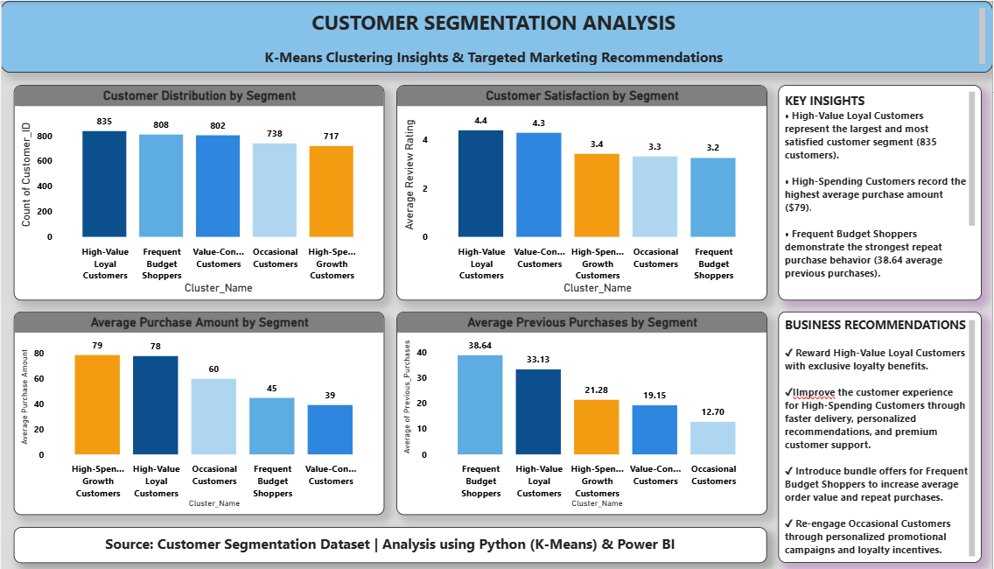
07
BUSINESS INTELLIGENCE
From Analysis to Always-On Decision Support
Dashboard 1 — Executive Performance Dashboard
Dashboard 2 — Customer Segmentation Dashboard
CUSTOMER SEGMENTATION & RETAIL GROWTH STRATEGY
Prepared by Sanchit Sunil Koli | 14

Slide 15
08
STRATEGIC RECOMMENDATIONS
Seven Priorities, Grounded in the Data
1
Segment-Led Loyalty Program
2
Targeted Outerwear Campaign
3
Youth Acquisition Strategy
Anchor a tiered loyalty program on Cluster 0; extend a lighter version to Clusters 2 & 3.
Time-bound seasonal awareness and merchandising, not continuous discounting.
Digital-first channel and messaging strategy for the 18–25 segment.
4
Experience Investment
5
Value-Segment Activation
6
Regional Two-Track Strategy
Faster service and personalization for Clusters 2 & 3 to close the satisfaction gap.
Cashback, bundles, and seasonal offers targeted at Cluster 1.
Acquisition focus in volume markets; premium offers in value markets.
7
Predictive Analytics (Next Phase)
Extend to RFM scoring and CLV modelling for proactive management.
CUSTOMER SEGMENTATION & RETAIL GROWTH STRATEGY
Prepared by Sanchit Sunil Koli | 15

Slide 16
08
BUSINESS IMPACT & ROADMAP
Phased Implementation, Measured Results
Phase 1 • 0–30 Days
Phase 2 • 30–90 Days
Phase 3 • 90–180 Days
Phase 4 • 180+ Days
Activate
Target
Retain
Predict
Launch Cluster 0 loyalty pilot; deploy both dashboards
Outerwear campaign, youth acquisition pilot, Cluster 1 offers
Experience investment for Clusters 2 & 3; regional rollout
Build RFM & CLV models; automate segment refresh
Success Metrics to Track
Revenue share and order volume growth in the Outerwear category, quarter-over-quarter.
Retention rate and repeat-purchase frequency within Cluster 0 and Cluster 3.
Average review rating trend within Cluster 2 and Cluster 3 following experience-investment initiatives.
Customer count growth within the 18–25 age group and average purchase uplift within Cluster 1.
CUSTOMER SEGMENTATION & RETAIL GROWTH STRATEGY
Prepared by Sanchit Sunil Koli | 16

Slide 17
CONCLUSION
Sharper Targeting Is the Path to Sustainable Growth
The customer base is composed of five behaviorally distinct segments with materially different value, satisfaction, and growth profiles.
Revenue is driven by customer volume, not individual spend — reframing where acquisition and retention investment should go.
Blanket discounting is not supported by the data; targeted, segment- and category-specific offers outperform broad promotions.
Two Power BI dashboards keep these findings live for ongoing management use beyond this engagement.
FINAL RECOMMENDATION
Approve the phased implementation plan, beginning with the Cluster 0 loyalty pilot and dashboard rollout within 30 days.
Prepared by
Sanchit Sunil Koli

